Slide 1
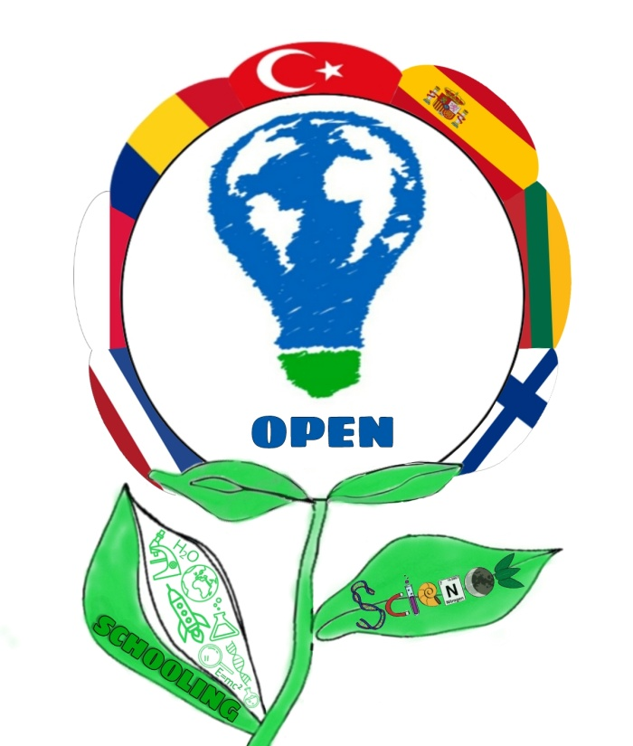
ECO-SYSTEMS OF OPEN SCIENCE SCHOOLING
ROMANIAN TEAM
ROMANIAN TEAM
``GHEORGHE ȚIȚEICA”
SCHOOL

Slide 2
Stimulates students to learn science better
Offers access to real life & real time science resources
Offers the opportunity to share their science missions
Ss become agents of change of their community well-being
Offers much more motivation than traditional science teaching
Is challenging & exciting
Is ROBUST
OPEN
SCIEN CE SCHOOLING

Slide 3
MISSION I
Outdoor School
Outdoor Education
Our school joined the national project-contest SCHOOL IN NATURE and we became partners of LIFE EDUCATION FOR ALL Association

Slide 4
Our school garden offered a friendly environment where students could develop their competences and socio-emotional abilities

Slide 5
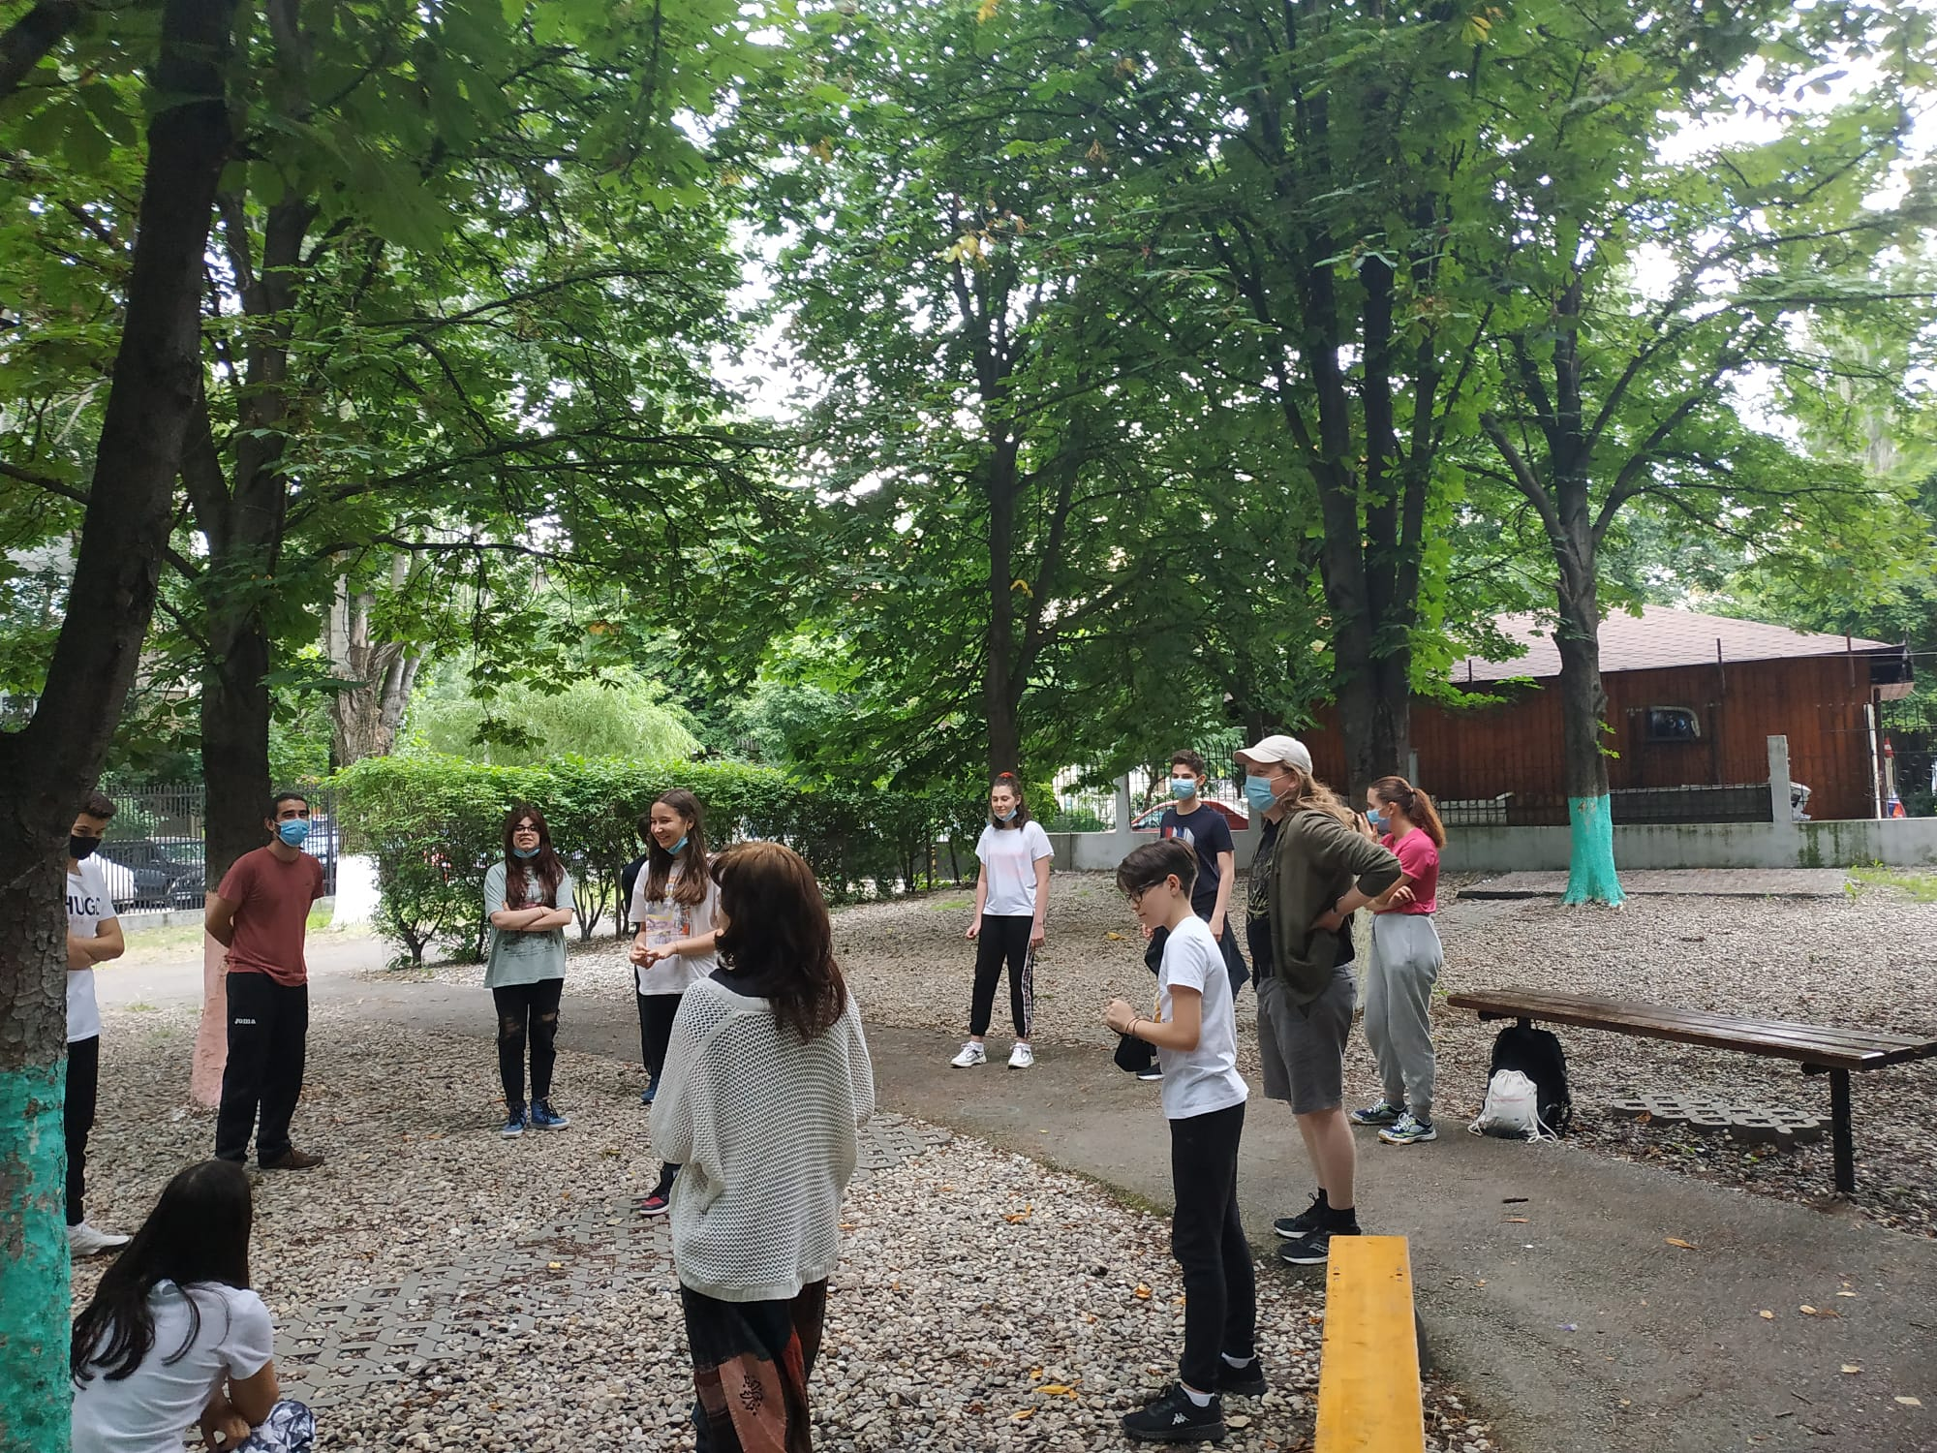
Workshops with volunteers from YOUTH COMMUNITIES
ASSOCIATION CRAIOVA

Slide 6
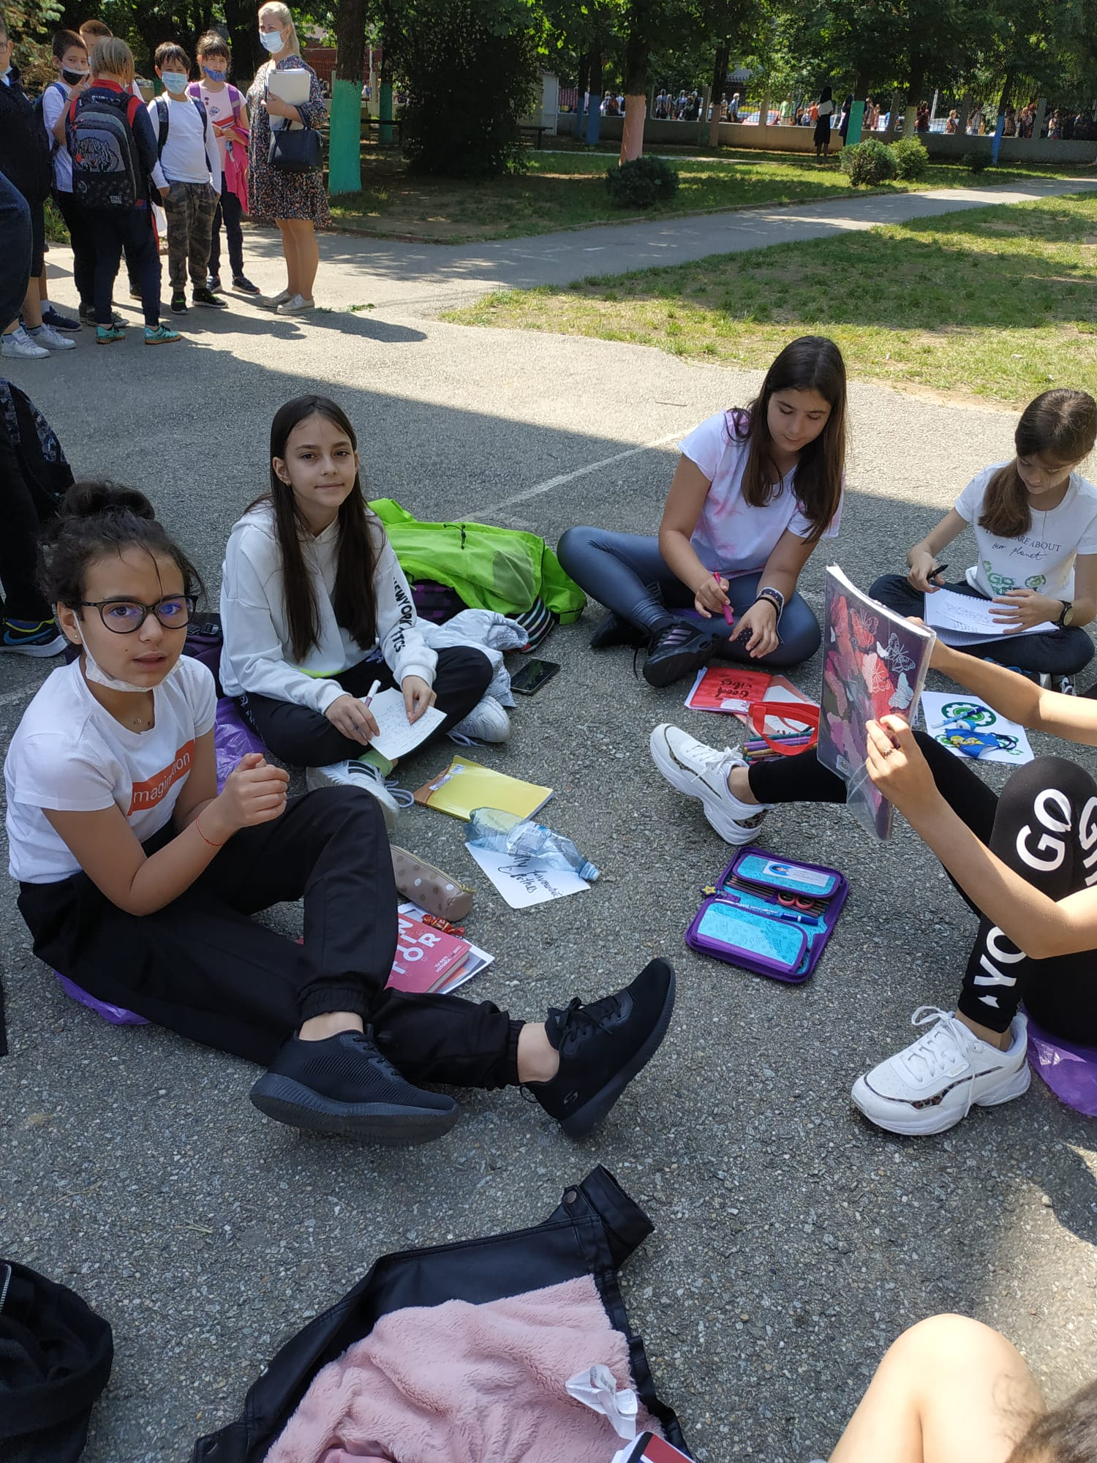
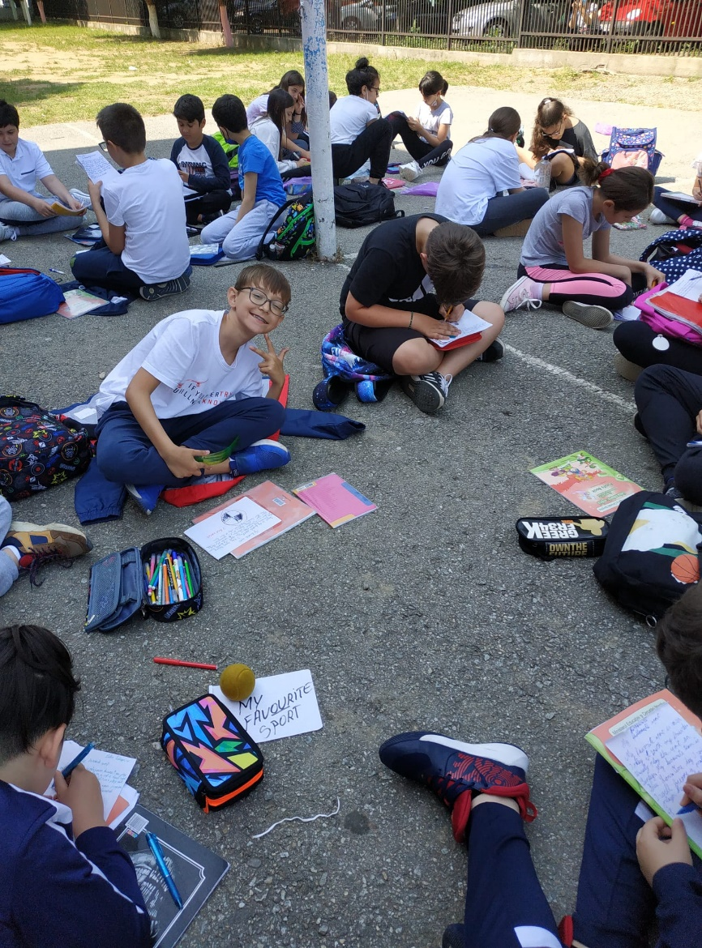
Collaboration Creativity
Critical thinking Communication
TRANSDISCIPLINARITY

Slide 7
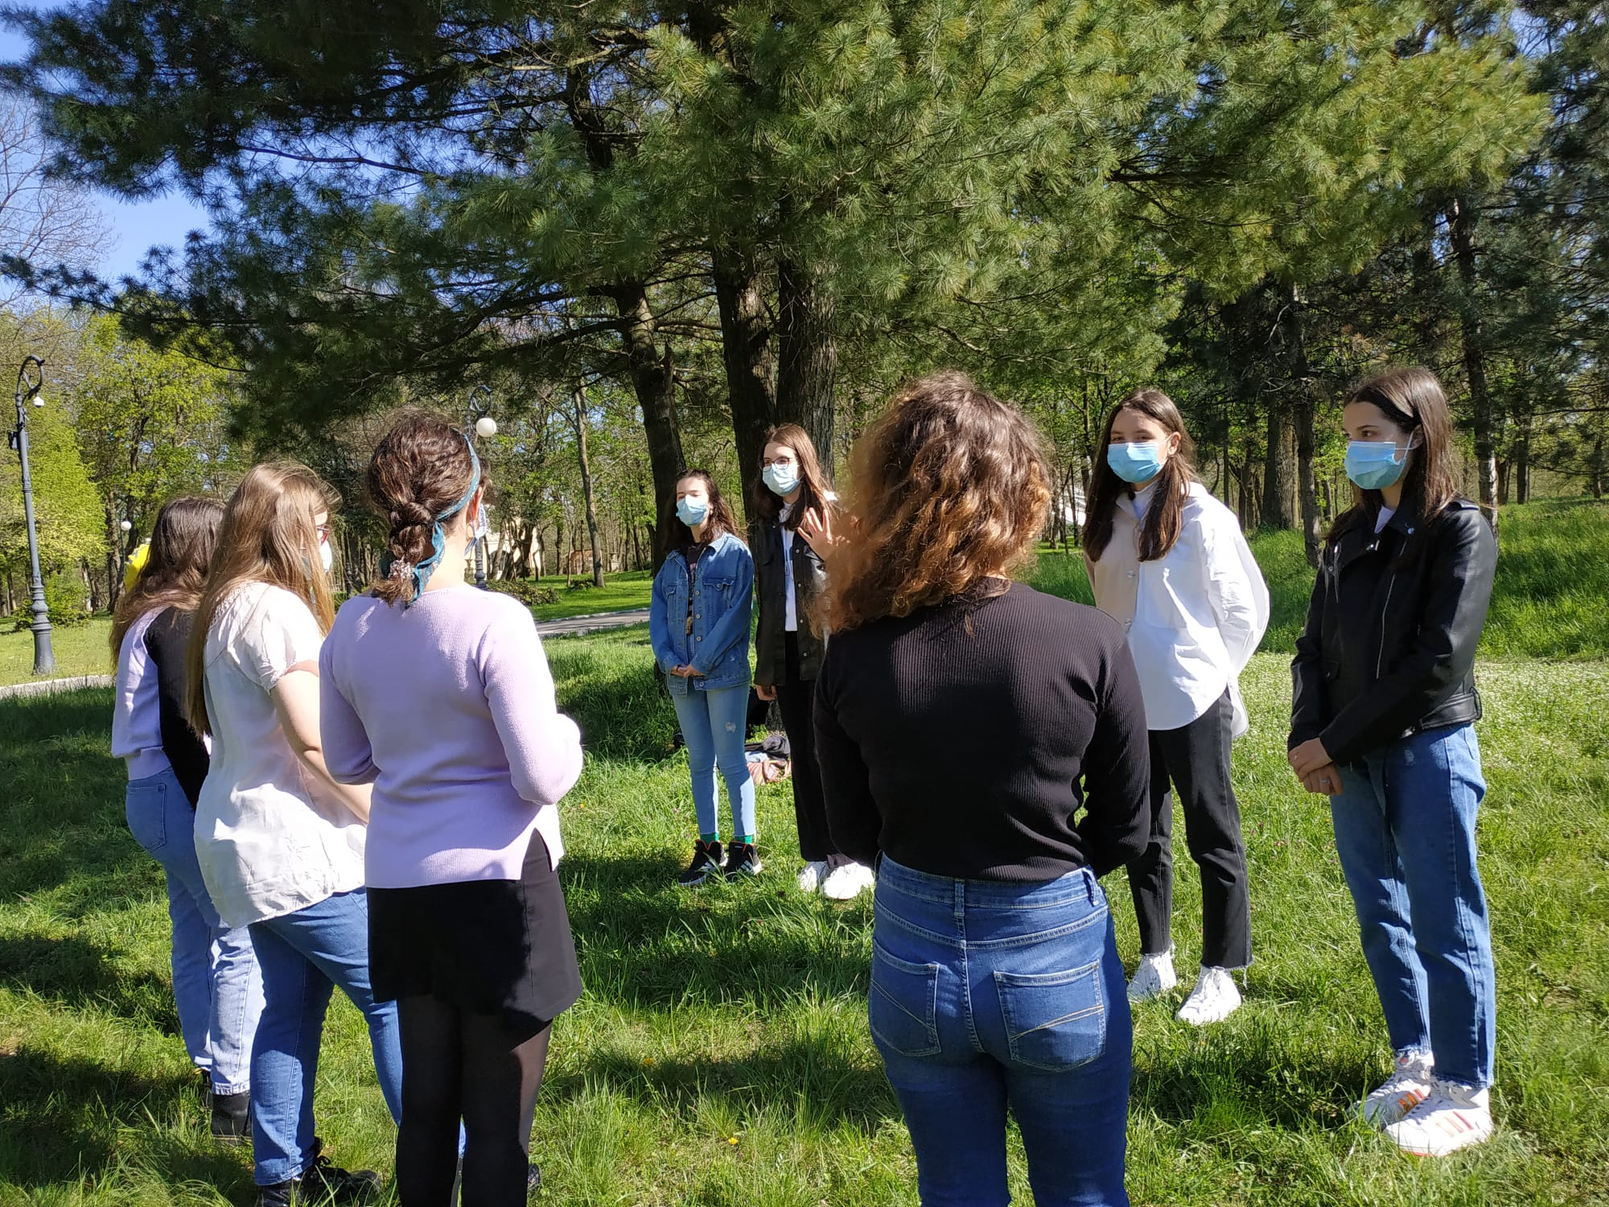
Games and interesting discussions about ENVIRONMENT in the Romanescu Park

Slide 8
Project-Based Learning

Slide 9
Stimulating students to appreciate the harmony of NATURE

Slide 10
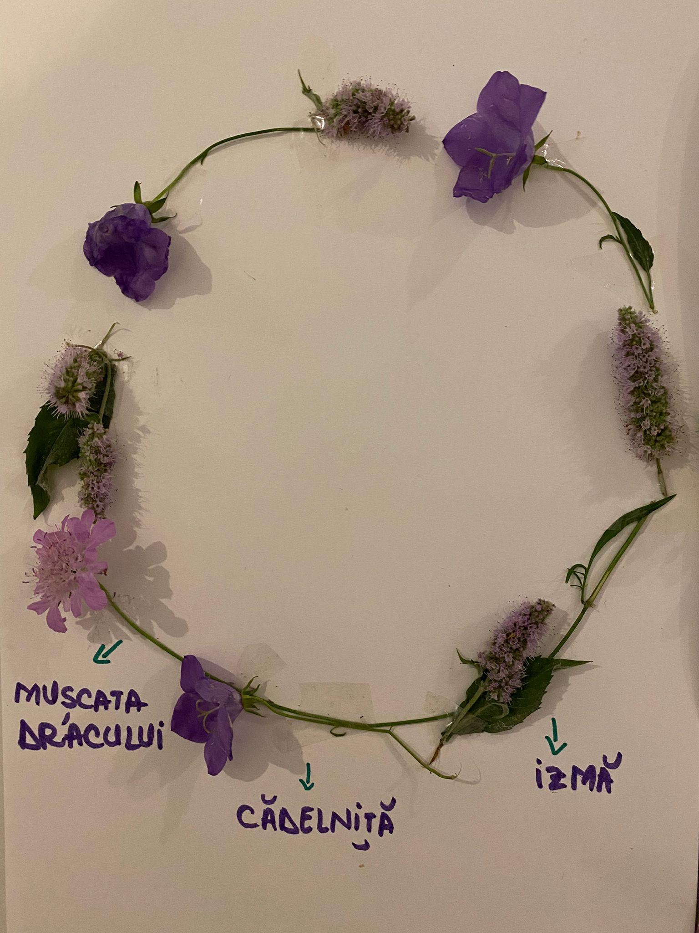
Using real life resources
Connected with NATURE

Slide 11
EDUCATION FOR SUSTAINABLE DEVELOPMENT
CARPATHIAN protected areas
Piatra Craiului National Park

Slide 12
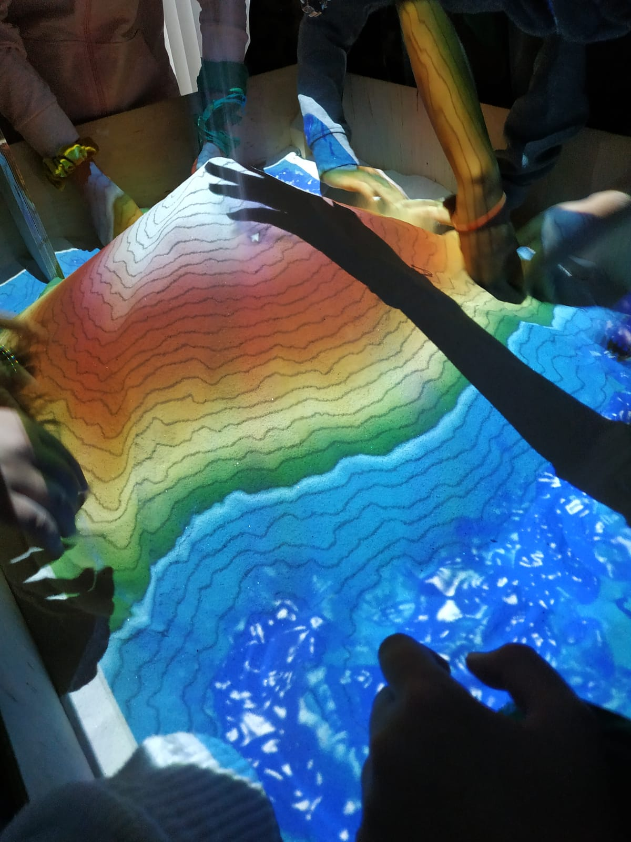
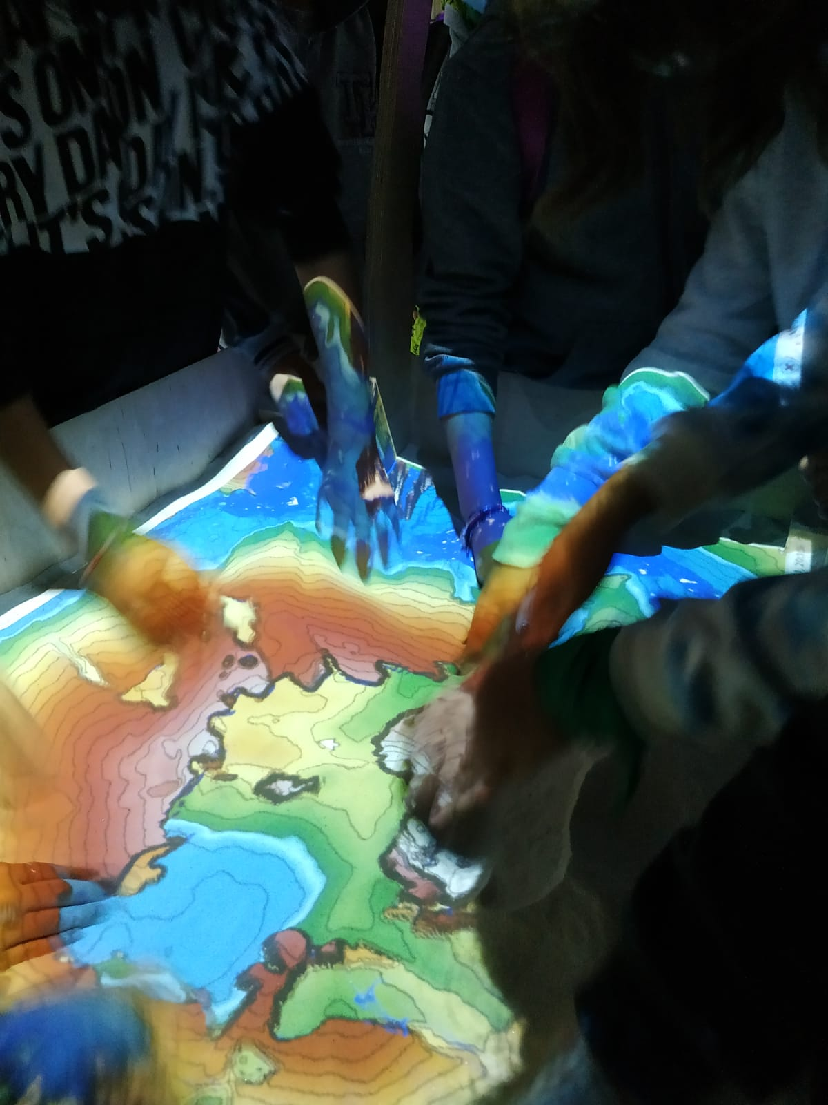
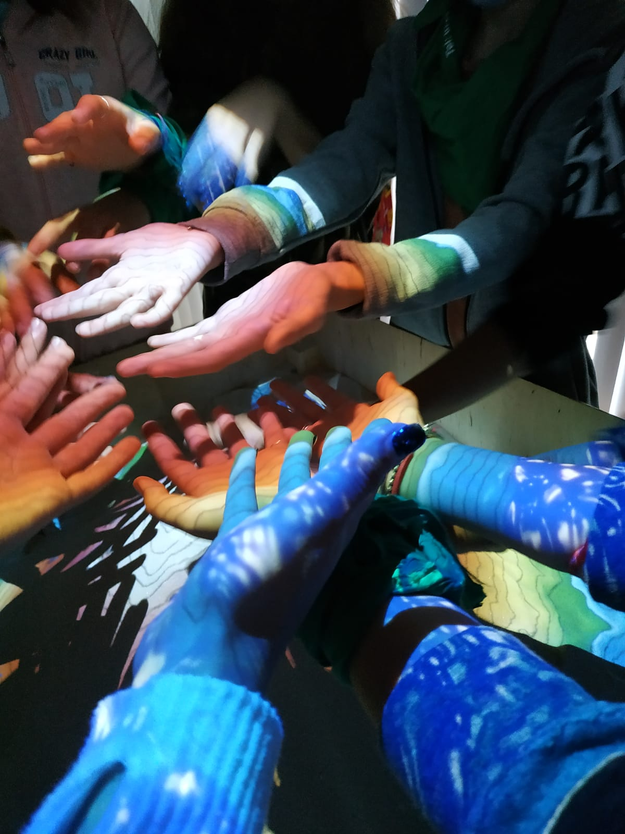
Discovering the relief forms with our senses National protected areas from stories to SCIENCE

Slide 13
MISSION 2
ENTREPRENEURIAL EDUCATION
Entrepreneurial networking& communication skills and competences for a Start Up business
START YUPI Project
READY FOR LIFE CAMP
22-29.08.2021,
Bran, Brasov County

Slide 14
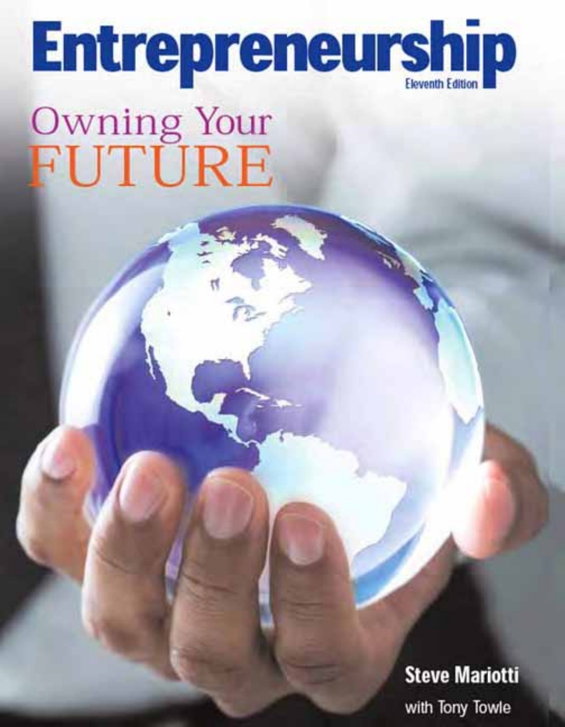

Slide 16
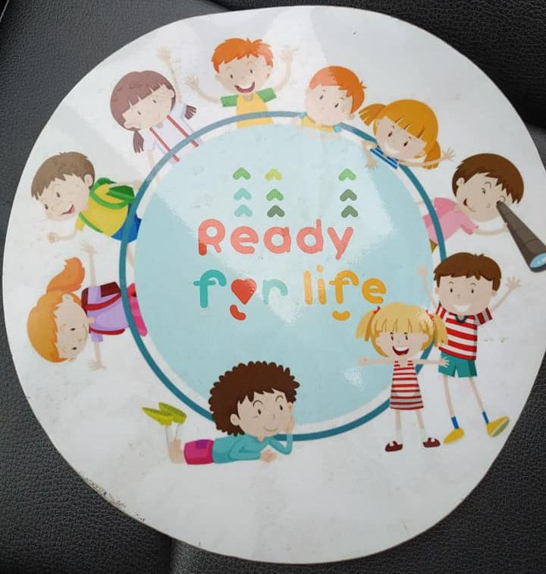
Entrepreneurial skills for the 21st century

Slide 17
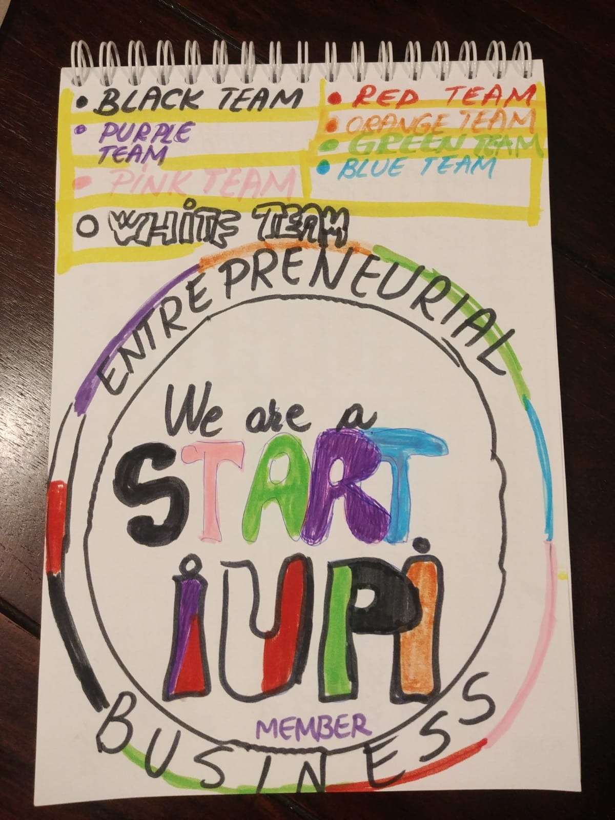
8 TARGET GROUPS AND MEMBER CARDS

Slide 18
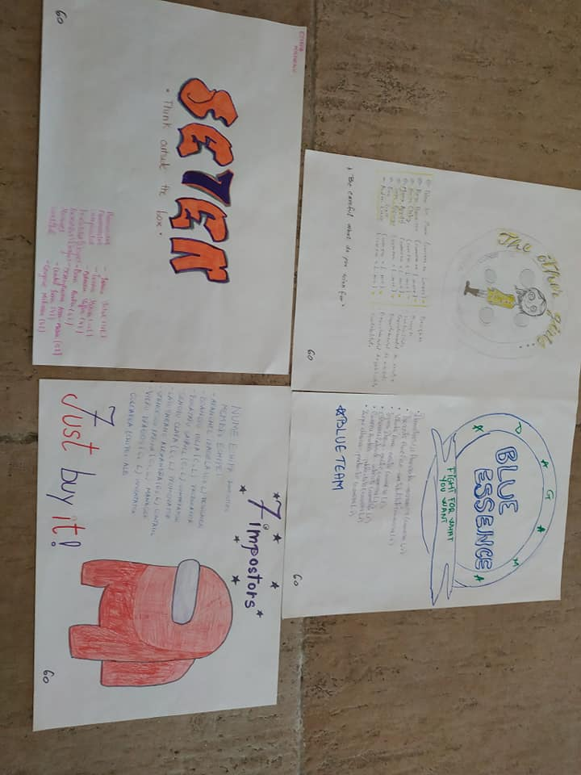
Sharing responsabilities Craft materials to be used

Slide 19
Innovation and Creative Department

Slide 20
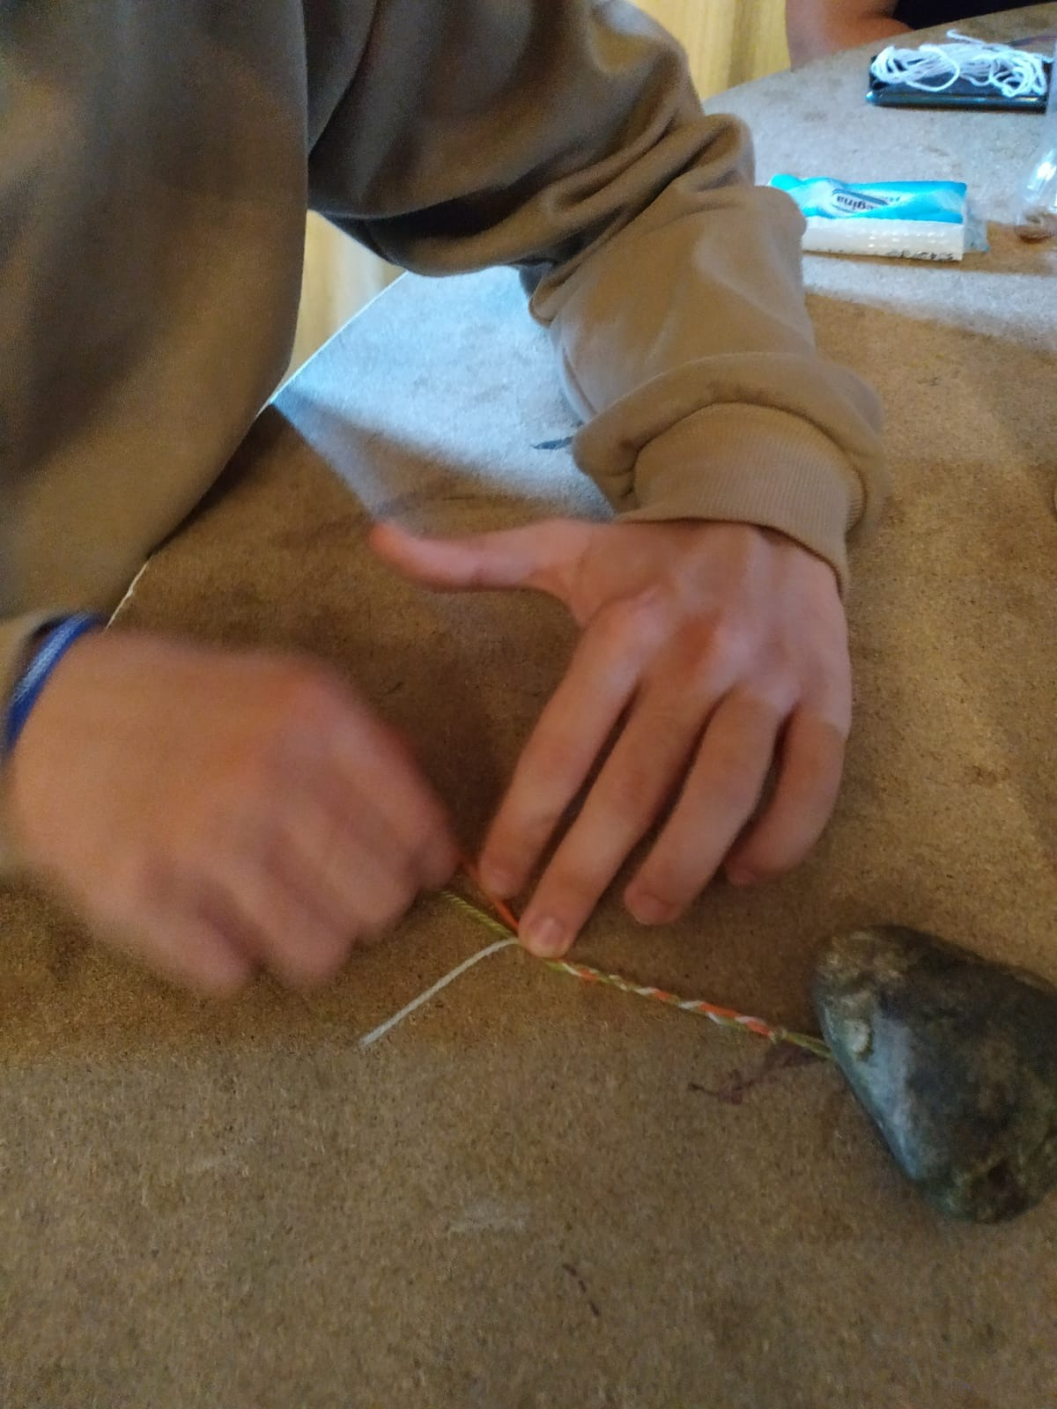
Cultivating teamwork spirit from I to WE

Slide 21
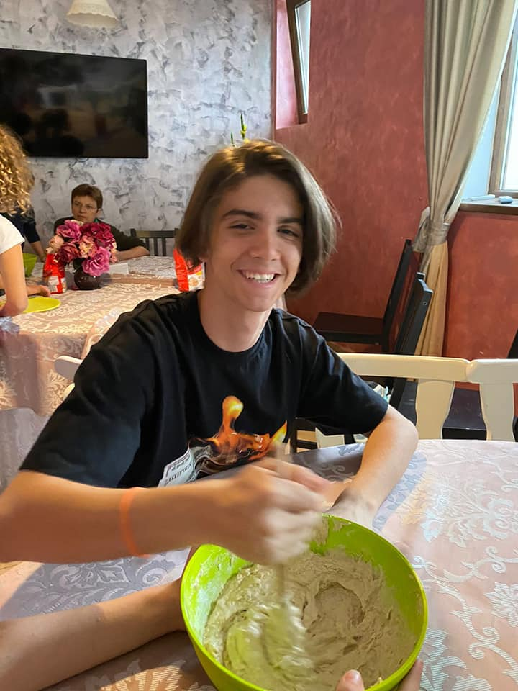
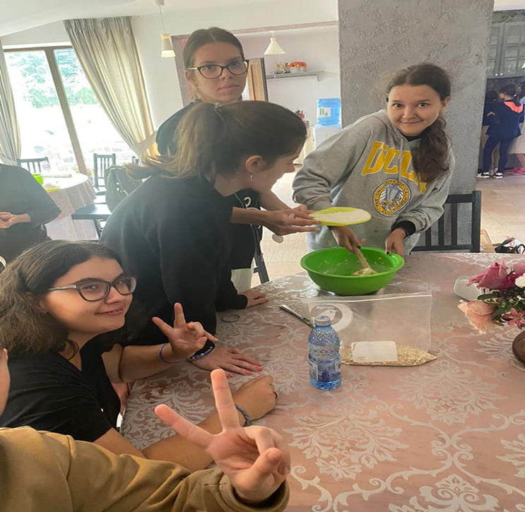
Vegan Cooking Factory Start Up Business

Slide 22
Set sail to Africa- Charity Society

Slide 23
Creative project evaluation
O pen science schooling
P roject
E mphasised that science learning should
N ot be a CLOSED BOX
S hifts the mind set of teachers & schools & society
C hange the way the science
H as been taught to youngsters
O f this generation in
O rder to keep their
L ove &
I nterest &
eNgagement alive
G lobally and locally
Think
the Box
Outside

Slide 25
